Slide 1

Lending Case Study

Slide 2
Objective-
Dataset Name – Loan Data
Numbers of records – 39717
Numbers of Columns – 111
Based on massive data set, we have to analysis which Data are relevant and Irrelevant behind the loan default.
We must figure out strong indicators of loan defaults.

Slide 3
Details of the Imp Columns-
LoanStatNew | Description
acc_now_delinq | The number of accounts on which the borrower is now delinquent.
acc_open_past_24mths | Number of trades opened in past 24 months.
addr_state | The state provided by the borrower in the loan application
all_util | Balance to credit limit on all trades
annual_inc | The self-reported annual income provided by the borrower during registration.
annual_inc_joint | The combined self-reported annual income provided by the co-borrowers during registration
application_type | Indicates whether the loan is an individual application or a joint application with two co-borrowers
avg_cur_bal | Average current balance of all accounts
bc_open_to_buy | Total open to buy on revolving bankcards.
bc_util | Ratio of total current balance to high credit/credit limit for all bankcard accounts.
chargeoff_within_12_mths | Number of charge-offs within 12 months
collection_recovery_fee | post charge off collection fee
collections_12_mths_ex_med | Number of collections in 12 months excluding medical collections
delinq_2yrs | The number of 30+ days past-due incidences of delinquency in the borrower's credit file for the past 2 years
delinq_amnt | The past-due amount owed for the accounts on which the borrower is now delinquent.
desc | Loan description provided by the borrower
dti | A ratio calculated using the borrower’s total monthly debt payments on the total debt obligations, excluding mortgage and the requested LC loan, divided by the borrower’s self-reported monthly income.
dti_joint | A ratio calculated using the co-borrowers' total monthly payments on the total debt obligations, excluding mortgages and the requested LC loan, divided by the co-borrowers' combined self-reported monthly income
earliest_cr_line | The month the borrower's earliest reported credit line was opened
emp_length | Employment length in years. Possible values are between 0 and 10 where 0 means less than one year and 10 means ten or more years.
emp_title | The job title supplied by the Borrower when applying for the loan.*
fico_range_high | The upper boundary range the borrower’s FICO at loan origination belongs to.
fico_range_low | The lower boundary range the borrower’s FICO at loan origination belongs to.
funded_amnt | The total amount committed to that loan at that point in time.
funded_amnt_inv | The total amount committed by investors for that loan at that point in time.

Slide 4
LoanStatNew | Description
grade | The total amount committed by investors for that loan at that point in time.
home_ownership | LC assigned loan grade
id | The home ownership status provided by the borrower during registration. Our values are: RENT, OWN, MORTGAGE, OTHER.
il_util | A unique LC assigned ID for the loan listing.
initial_list_status | Ratio of total current balance to high credit/credit limit on all install acct
inq_fi | The initial listing status of the loan. Possible values are – W, F
inq_last_12m | Number of personal finance inquiries
inq_last_6mths | Number of credit inquiries in past 12 months
installment | The number of inquiries in past 6 months (excluding auto and mortgage inquiries)
int_rate | The monthly payment owed by the borrower if the loan originates.
issue_d | Interest Rate on the loan
last_credit_pull_d | The month which the loan was funded
last_fico_range_high | The most recent month LC pulled credit for this loan
last_fico_range_low | The upper boundary range the borrower’s last FICO pulled belongs to.
last_pymnt_amnt | The lower boundary range the borrower’s last FICO pulled belongs to.
last_pymnt_d | Last total payment amount received
loan_amnt | Last month payment was received
loan_status | The listed amount of the loan applied for by the borrower. If at some point in time, the credit department reduces the loan amount, then it will be reflected in this value.
max_bal_bc | Current status of the loan
member_id | Maximum current balance owed on all revolving accounts
mo_sin_old_il_acct | A unique LC assigned Id for the borrower member.
mo_sin_old_rev_tl_op | Months since oldest bank installment account opened
mo_sin_rcnt_rev_tl_op | Months since oldest revolving account opened
mo_sin_rcnt_tl | Months since most recent revolving account opened

Slide 5
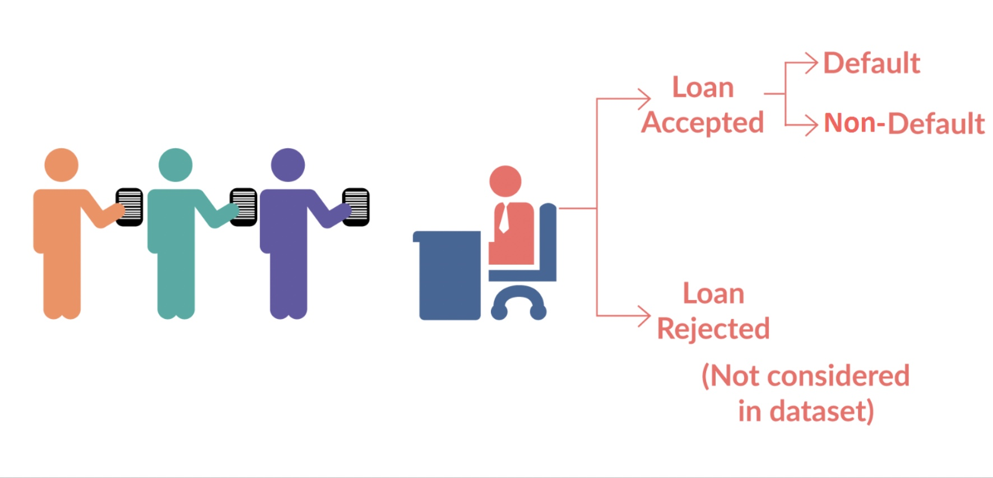
Business Overview

Slide 6
Step 1 – Data Analysis and cleansing
Loaded the data to Pandas Data frame.
Missing Value treatment - Identified the columns that have all null records & delete those columns.
Unwanted column treatment – Identified the columns adding no value and removed the columns.
Replace the values with Mean value incase we have number of zero.
Changed term from string value to integer value.
Example of Data Cleansing : Fix rows and columns
Fix missing values
Standardise values
Fix invalid values
Filter data

Slide 7
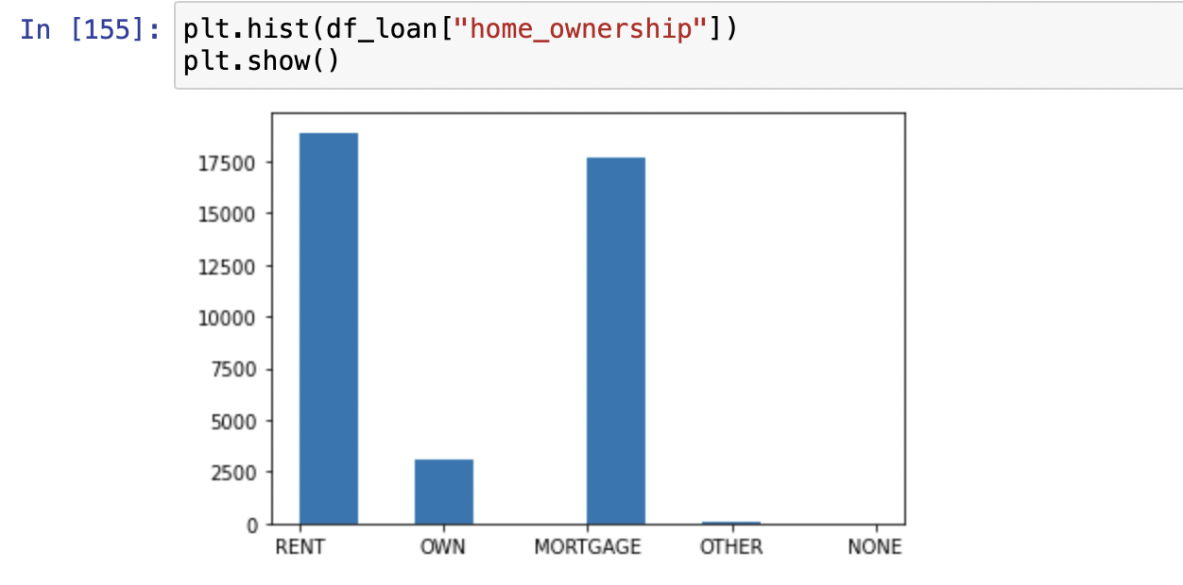
Step 2 – Univariate Analysis
Univariate analysis is the simplest form of analysing data. “Uni” means “one”, so in other words your data has only one variable.
Its major purpose is to describe , takes data, summarizes that data and finds patterns in the data.
Categorical Variables types --
Unordered categorical
Ordered categorical

Slide 8
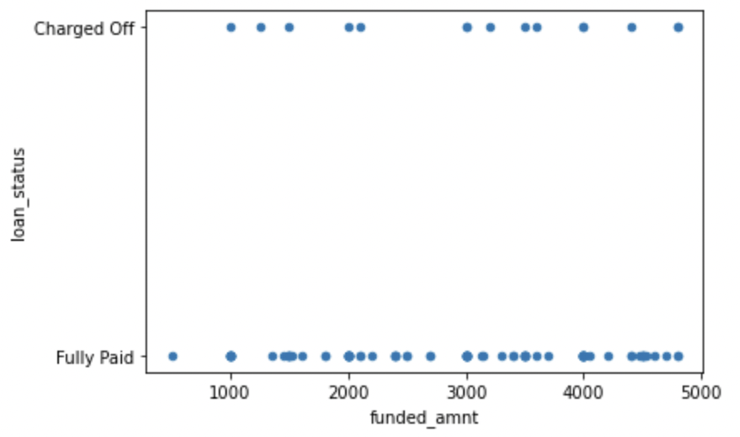
Step 3 – Bivariate Analysis
Bivariate analysis is one of the simplest forms of quantitively analysis. It involves the analysis of two variables (often denoted as X, Y), for the purpose of determining the empirical relationship between them.
. Broadly two types of Bivariate analysis.
Bivariate analysis on continuous variables
Bivariate analysis on categorical variables
Performed the Bivariate analysis on various Categorical variables with respect to loan status.
This analysis provided the guidance on impact of one variable on the other.
As Loan_Status is the target variable, so various variable relations are applied on this.
With the bivariate analysis, we can conclude Lower grade and higher Interest rates has more defaulters.

Slide 9
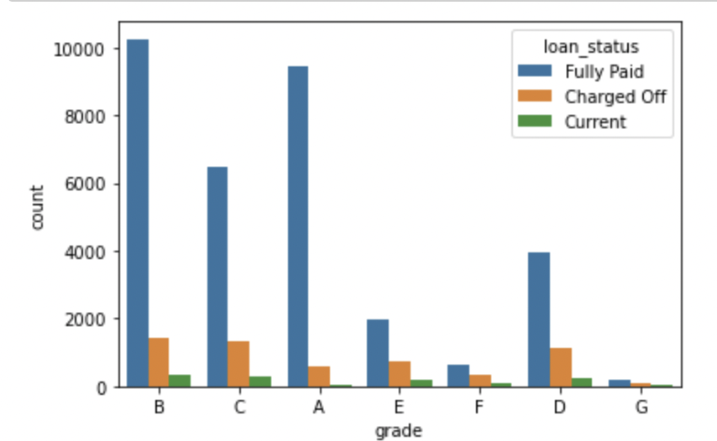
Conclusion
Based on Data analysis we can conclude that there are many factors which are less imp and hardly contributes towards the Loan status.
We have removed around 56 unwanted column and close to 8 column required data adjustment.
Grade, Interest Rate, Annual Income, Funded Amount and Emp length are important factors which contributes directly towards loan status.

